Slide 1
RELATIONSHIP BETWEEN PROCESSES
0
+1
-3

Slide 2
Table of contents
01
02
03
04
Fields of a process descriptor used to express parenthood relationships
The fields of the process descriptor that establish non-parenthood relationships
The pidhash table and chained lists
The fields of the pid data structures
+8

Slide 3
01
Fields of a process descriptor used to express parenthood relationships
+7
-5
-4

Slide 4
What are integers?
Processes created by a program have a parent/child relationship.
When a process creates multiple children , these children have sibling relationships.
Several fields must be introduced in a process descriptor to represent these relationships to a given process P.
Processes 0 and 1 are created by the kernel.
Process 1 (init) is the ancestor of all other processes.
-2
+1

Slide 5
parent:
Points to the process descriptor of the parent process.
real_parent:
Points to the process descriptor of the "real" parent process, which is the process that created this process.
This field is used for handling cases where the parent process changes (e.g., when a process is adopted
by init after its original parent exits).
children:
The head of a list of all child processes. This is a doubly linked list where each entry
represents a child process.
sibling:
Used to link the process to the list of sibling processes, which share the same parent.
This field points to the next sibling in the list.
ptraced:
Points to a list of processes that are being traced by this process. This is relevant for debugging
and other process control mechanisms.
p_opptr:
Points to the original parent process (before any ptrace operation).
p_pptr:
Points to the current parent process (can change if the process is reparented).

Slide 6
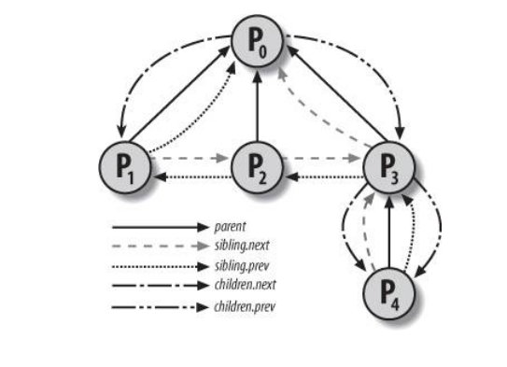

Slide 7
02
The fields of the process descriptor that establish non-parenthood relationships
+8
+3

Slide 8
The fields of the process descriptor that establish non-parenthood relationships
group_leader: Process descriptor pointer of the group leader of the process (P).
signal->pgrp: PID of the group leader of P.
tgid: PID of the thread group leader of P.
signal->session: PID of the login session leader of P.
ptrace_children: The head of a list containing all children of P being traced by
a debugger.
ptrace_list: Pointers to the next and previous elements in the real parent’s
list of traced processes (used when P is being traced).

Slide 9
Scanning the process list sequentially and checking the PID fields of process
descriptors is feasible but inefficient.
To speed up the search, four hash tables have been introduced.
Hash Table Type | Field Name | Description
PIDTYPE_SID | session | PID of the session leader
PIDTYPE_PGID | pgrp | PID of the process group leader
PIDTYPE_TGID | tgid | PID of the thread group leader
PIDTYPE_PID | pid | PID of the process

Slide 10
03
The pid hashtable and chained list
+8
+3

Slide 11
The pid hashtable and chained list
In several circumstances, the kernel must be able to derive the process descriptor pointer corresponding to a PID.
This occurs, for instance, in servicing the kill( ) system call.
When process P1 wishes to send a signal to another process, P2, it invokes the kill( ) system call specifying the PID of P2 as the parameter. The kernel derives the process descriptor pointer from the PID and then extracts the pointer to the data structure that records the pending signals from P2's process descriptor.
+5
+3

Slide 12
The four hash tables are dynamically allocated during the kernel initialization phase.
The size of a single hash table depends on the amount of available RAM.
Example: For systems with 512 MB of RAM, each hash table has 2,048 entries
The PID is transformed into a table index using the pid_hashfn macro.
The macro uses the hash_long() function, which is optimized for 32-bit architecture.

Slide 13
PID to Table Index Transformation
The PID is transformed into a table index using the pid_hashfn macro.
The pid_hashfn(x) macro expands to:
#define pid_hashfn(x) hash_long((unsigned long) x, pidhash_shift)
The pidhash_shift variable stores the length in bits of a table index (11, in our example).

Slide 14
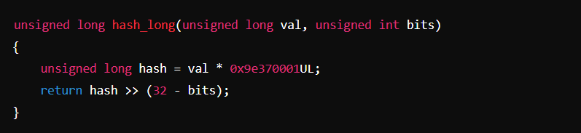
The hash_long function
The hash_long() function, used by many hash functions, is essentially equivalent to
In this example, since pidhash_shift is equal to 11, pid_hashfn yields values ranging between 0 and
2047 (i.e., 2^11 - 1).

Slide 15
Magic Constant
The constant 0x9e370001 in the hash function is a prime number,
chosen for its properties related to the golden ratio.
This choice improves the distribution of PIDs in the hash table.

Slide 16
Handling Collisions
Collisions occur when two different PIDs hash into the same table index.
Linux uses chaining to handle these collisions, linking colliding process
descriptors in a doubly linked list.

Slide 17
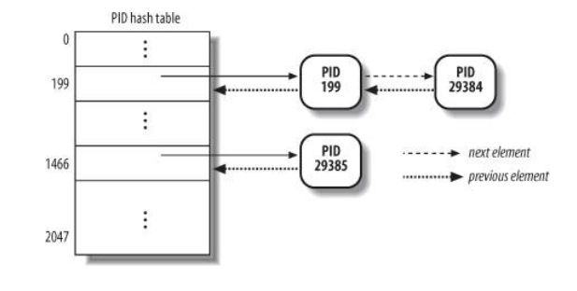
The diagram shows how PIDs 2,890 and 29,384 hash into the same table index (200th element) and are linked.

Slide 18
04
The fields of pid data structure
+8
+3

Slide 19
The PID hash tables must manage relationships between processes,
such as retrieving all processes in a thread group or session.
Type | Name | Description
int | nr | The PID number
struct hlist_node | pid_chain | Links to the next and previous elements in the list
struct list_head | pid_list | The head of the per-PID list

Slide 20
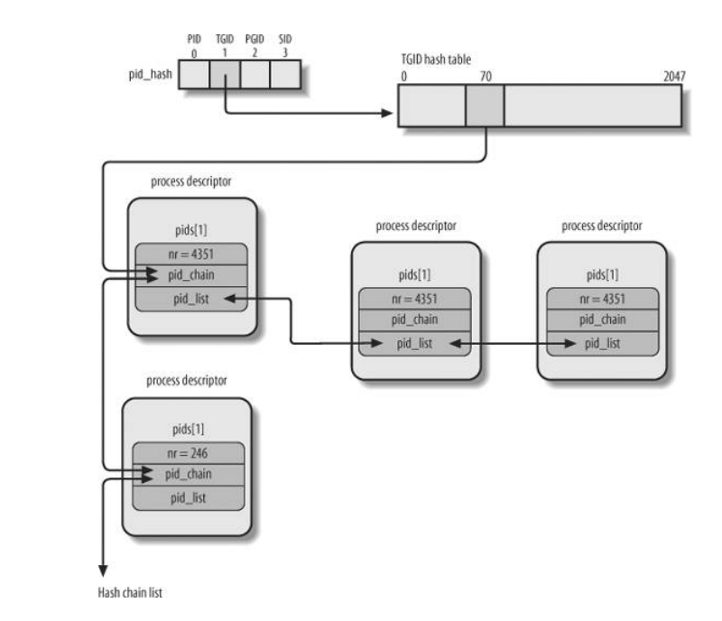

Slide 21
Functions and Macros
do_each_task_pid(nr, type, task)
while_each_task_pid(nr, type, task)
find_task_by_pid_type(type, nr)
find_task_by_pid(nr)
attach_pid(task, type, nr)
detach_pid(task, type)
next_thread(task)

Slide 22
THANK YOU
+8
+3

